Slide 1
Presentation of mini project on
“Prediction of profit value of company using ML”
Submitted By:
Kundan Dhore
Submitted for : Exposys Data Labs, Bangalore

Slide 2
ABSTRACT
A company should always set a goal that should be achievable, otherwise, employees will not be able to work to their best potential if they find that the goal set by the company is unachievable. The task of profit prediction for a particular period is the same as setting goals. If you know how much profit you can make with the amount of R&D and marketing you do, then a business can make more than the predicted profit provided the predicted value is achievable.
So in this project, I will be predicting profit of company using R&D Spend, Administration Cost and Marketing Spend of the company with machine learning using Python.

Slide 3
CHAPTER 1
INTRODUCTION
In today’s world, data are produced everywhere now and then.
These information’s are being used to provide a personalized environment to the user. It is true that these data are quite large, and they can't be processed by a single person or a team because their sources of production make them grow tremendously. Thus, Machine Learning makes use of AI.
Hence, Machine Learning uses all these data and provides what people concept is used to predict the profit of a company as it is very difficult to determine or predict the profit of a company as there are many factors that influence it, such as the cost of R&D, marketing, and company standards.
These increased factors that affects the profit of a company make things unpredictable by an average individual.
Thus, based on the past profit record and administration costs of the companies, a model is created which recognizes a pattern via the factors affecting profit in order to better predict profit.

Slide 4
CHAPTER 3
PROBLEM STATEMENT
In the given dataset, R&D Spend, Administration Cost and Marketing Spend of 50 Companies are given along with the profit earned. The target is to prepare an ML model which can predict the profit value of a company if the value of its R&D Spend, Administration Cost and Marketing Spend are given.
i) Constructing Different Regression algorithms
ii) Dividing the data into train set and test set
iii) Calculating different regression metrics
iv) Choosing the best model

Slide 5
CHAPTER 4
EXISTING SYSTEM
By using a single independent variable such as the investment cost of a company’s project, the value of the dependent variable i.e., the profit of the company by the means of that project is approximately predicted.
Linear regression makes use of a single independent variable to predict the value of a dependent variable by developing a regression line along the given data and thereby predicting dependent variable using that regression line.
Disadvantages of the existing system
• Linear regression makes use of only one independent variable and so results are less accurate.
• Data are not completely consumed by a linear regression model

Slide 6
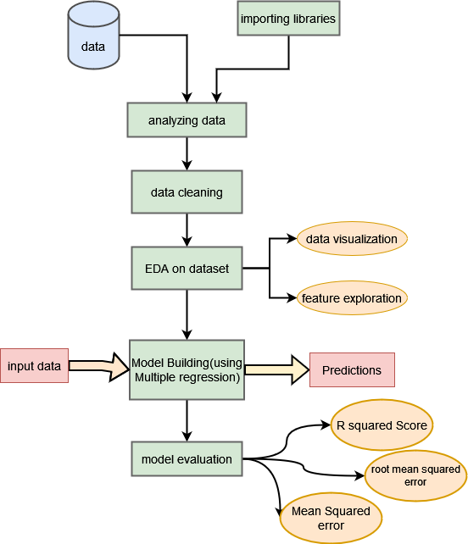
CHAPTER 5
PROPOSED SYSTEM
The main intention is to predict the value of the dependent variable i.e., the value of the profit of the company based on the data of the company over the previous years.
So, from all the techniques used before for the prediction of profit an average from all those predicted values of the dependent variable is computed and made as the predicted dependent variable.
Advantages of the proposed system
• It makes use of all the data given to it to predict the value of independent variable.
• Theoretically it is better than all the other existing algorithms
Figure :- Process Flow Diagram

Slide 7
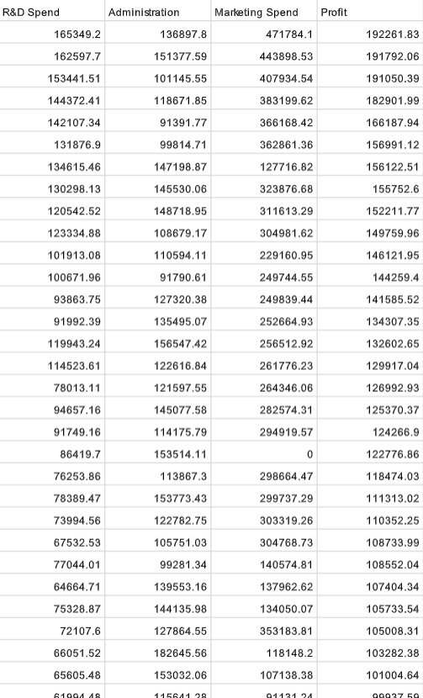
CHAPTER 6
IMPLEMENTATION
Data analyzing
Data Cleaning
ML
model
Result
Evaluation
visualization
Dividing data
dataset

Slide 8
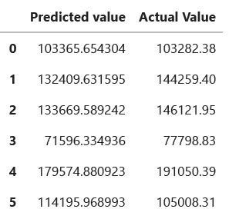
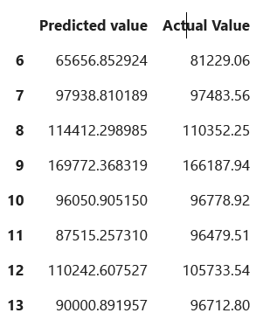
CHAPTER 7
RESULT
Figure :- result

Slide 9
CHAPTER 8
CONCLUSION
This is how we can predict the profit of a company for a particular period by using machine learning algorithm. Such tasks can help a company to set a target that can be achieved and boost up revenue. In real life, it can be generalized as a universal template for all companies with the same financial form. For investors who prefer medium and long-term investment, it has certain reference significance.

Slide 10
REFERENCES
1. Understanding Multiple Regression (The fundamental basis)
2. https://towardsdatascience.com/understanding-multiple-regression-249b16bde83e.
3. Support Vector Regression Tutorial for Machine Learning,
4. https://www.analyticsvidhya.com/blog/2020/03/support-vector-regression-tutorial-for-machinelearning/ .
5. An introduction to support vector regression, https://towardsdatascience.com/an introduction-tosupport-vector-regression-svr-a3ebc1672c2

Slide 11
Thank You!!!

